Slide 1
Chapter 5
Using Predicate Logic

Slide 2
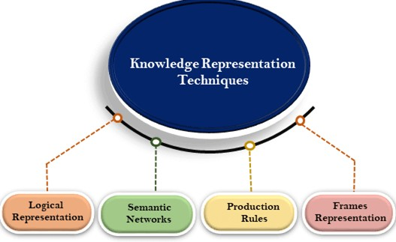
Knowledge Representation Techniques
How this knowledge can be represented so that a machine can make sense of it. One has to keep in mind that there are numerous ways to achieve this, and no method is perfect and has its own disadvantages.

Slide 3
Conti.
Logical Representation
It is the most basic form of representing knowledge to machines where a well-defined syntax with proper rules is used.
This syntax needs to have no ambiguity in its meaning and must deal with prepositions.
Thus, this logical form of presentation acts as communication rules and is why it can be best used when representing facts to a machine.
Logical representation can be categorised into mainly two logics:
Propositional Logics
Predicate logics

Slide 4
Conti.
Logical Representation can be of two types-
Propositional Logic: This type of logical representation is also known as propositional calculus or statement logic. This works in a Boolean, i.e., True or False method.
e.g. the sun rises from west. (false preposition)
it is sunday.
5 is a prime number.
3+3 = 7. (false preposition)
First-order Logic: This type of logical representation is also known as the First Order Predicate Calculus Logic (FOPL). This logical representation represents the objects in quantifiers and predicates and is an advanced version of propositional logic.
Prdicates like relation, constant, variable, function, connectives(and, or, not etc.), equality etc.
e.g. some humans are intelligent.
sachin likes cricket.

Slide 5
Conti.
Logical Representation
Advantages:
Logical representation helps to perform logical reasoning
This representation is the basis for the programming languages.
Disadvantages:
Logical representations have some restrictions and are challenging to work with
This technique may not be very natural and inference may not be very efficient.

Slide 6
Conti.
Semantic Networks
In this form, a graphical representation conveys how the objects are connected and are often used with a data network.
The Semantic networks consist of node/block (the objects) and arcs/edges (the connections) that explain how the objects are connected. This form of representation is also known as an alternative to the FOPL form of representation.
The relationships found in the Semantic Networks can be of two types – IS-A and instance (KIND-OF). This form of representation is more natural than logical. It is simple to understand however suffers from being computationally expensive and do not have the equivalent of quantifiers found in the logical representation.

Slide 7
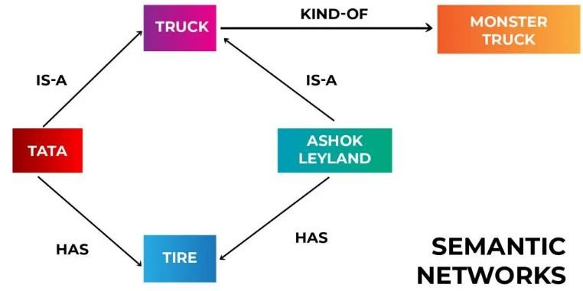
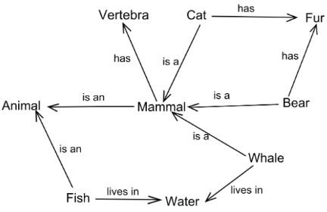
Conti.
A knowledge representation that represents relationships between concepts and ideas in the form of a network. It is generally shown as a graph where concepts/ideas are “nodes” and relationships are “edges” or arrows

Slide 8
Conti.
Advantages:
Semantic networks are a natural representation of knowledge
It conveys meaning in a transparent manner
These networks are simple and easy to understand
Disadvantages:
Semantic networks takes more computational time at runtime
These are inadequate as they do not have any equivalent quantifiers.
These networks are not intelligent and depends on the creator of the system.

Slide 9
Conti.
Frame Representation
It is a collection of attributes and values linked to it. This AI-specific data structure uses slots and fillers (i.e., slot values, which can be of any data type and shape).
It has a similar concept to how information is stored in a typical DBMS. These slots and fillers form a structure – a frame. The slots here have the name (attributes), and knowledge related to it is stored in the fillers.
The biggest advantage of this form of representation is that due to its structure, similar data can be combined in groups as frame representation can divide the knowledge in structures and then further into sub-structures. Also, being like any typical data structure can be understood, visualized, manipulated easily, and typical concepts such as adding, removing, deleting slots can be done effortlessly.

Slide 10
Conti.
E.g.
Slots | Fillers
Name | Peter
Profession | Doctor
Age | 25
Marital Status | Single
Weight | 78
Slots | Fillers
Title | Artificial Intelligence
Genre | Computer Science
Author | Peter Norvig
Edition | Third Edition
Year | 1996
Page | 1152

Slide 11
Conti.
Advantages:
It makes the programming easier by grouping the related data.
Frame representation is easy to understand and visualize.
It is very easy to add slots for new attributes and relations also it is easy to include default data and search for missing values.
Disadvantages:
In frame system inference, the mechanism can not be easily processed.
The inference mechanism can not be smoothly processed by frame representation.
It is very generalized approach.

Slide 12
Conti.
Production Rules
It is among the most common ways in which knowledge is represented in AI systems. In the simplest form, it can be understood as a simple if-else rule-based system and, in a way, is the combination of Propositional and FOPL logics.
This system comprises a set of production rules, rule applier, working memory, and a recognize act cycle. For every input, conditions are checked from the set of a production rule, and upon finding a suitable rule, an action is committed. This cycle of selecting the rule based on some conditions and consequently acting to solve the problem is known as a recognition and act cycle, which takes place for every input.

Slide 13
Conti.
Advantages:
Expressed in natural language
Production rules are highly modular and can be easily removed or modified.
Disadvantages:
It does not exhibit any learning capabilities and does not store the result of the problem for future uses.
During the execution of program many rules may be active. Thus rule based production systems are inefficient.

Slide 14
Logical Representation-Propositional Logic
Propositional Logic- One of the simplest method for representing knowledge
A statement can be defined as a declarative sentence, or part of a sentence, that is capable of having a truth-value, such as being true or false. So Propositions can be either true or false, but it cannot be both.
e.g.
Paris is the capital of France.
Everyone born on Monday has purple hair.
Sometimes, a statement can contain one or more other statements as parts.

Slide 15
Logical Representation-Propositional Logic
Atomic Proposition: Atomic propositions are the simple propositions. It consists of a single proposition symbol. These are the sentences which must be either true or false.
e.g.
2+2 is 4, it is an atomic proposition as it is a true fact.
"The Sun is cold" is also a proposition as it is a false fact.
Compound Proposition: Compound propositions are constructed by combining simpler or atomic propositions, using parenthesis and logical connectives.
e.g.
"It is raining today, and street is wet."
"Ankit is a doctor, and his clinic is in Mumbai."
“Paris is the capital of France and Paris has a population of over two million."

Slide 16
Logical Representation-Propositional Logic
Propositional logic is also called Boolean logic as it works on 0 and 1.
In propositional logic, we use symbolic variables to represent the logic, and we can use any symbol for a representing a proposition, such A, B, C, P, Q, R, etc.
Propositional logic consists of an object and logical connectives. These connectives are also called logical operators.
The propositions and connectives are the basic elements of the propositional logic.
Connectives can be said as a logical operator which connects two sentences.

Slide 17
Logical Connectives
Logical connectives are used to connect two simpler propositions or representing a sentence logically. We can create compound propositions with the help of logical connectives. There are mainly five connectives, which are given as follows:
Negation: A sentence such as ¬P is called negation of P. A literal can be either Positive literal or negative literal.
Conjunction: A sentence which has 𝖠 connective such as, P 𝖠 Q is called a conjunction.
Example: Rohan is intelligent and hardworking. It can be written as,
P= Rohan is intelligent, Q= Rohan is hardworking. → P 𝖠 Q.
Disjunction: A sentence which has ∨ connective, such as P ∨ Q. is called disjunction, where P and Q are the propositions.
Example: Ritika is a doctor or Engineer
P= Ritika is Doctor, Q= Ritika is Engineer → P ∨ Q.

Slide 18
Logical Connectives
Implication: A sentence such as P → Q, is called an implication. Implications are also known as if-then rules. It can be represented as
Example: If it is raining, then the street is wet.
P= It is raining, Q= Street is wet :- P → Q
Biconditional: A sentence such as P⇔Q is a Biconditional sentence,
Example: If I am breathing, then I am alive
P= I am breathing, Q= I am alive, it can be represented as P ⇔ Q.

Slide 19
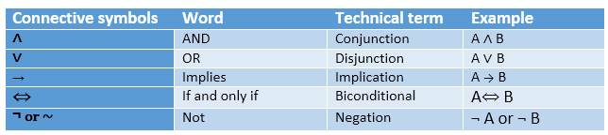
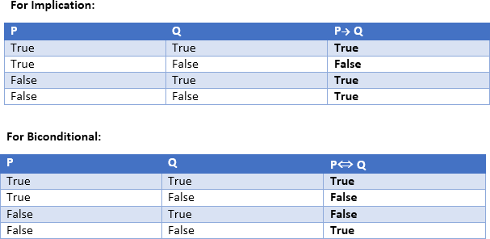
Logical Connectives
Truth Table

Slide 20
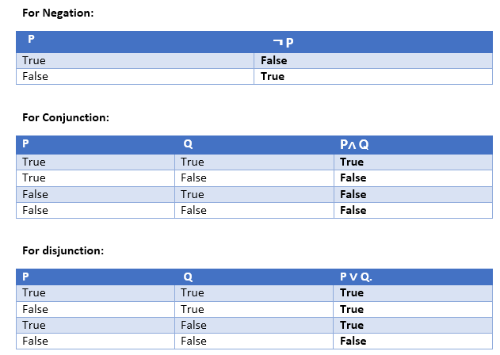
Logical Connectives
Truth Table

Slide 21
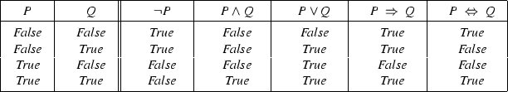
Propositional Logic
For propositional logic, a row in the truth table is one interpretation

Slide 22
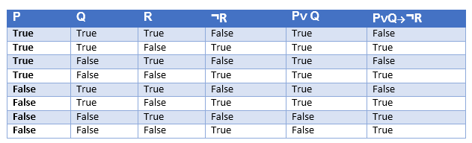
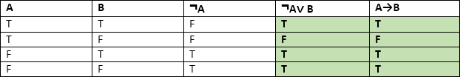
Logical Connectives
Truth table with three propositions:
Logical equivalence:

Slide 23
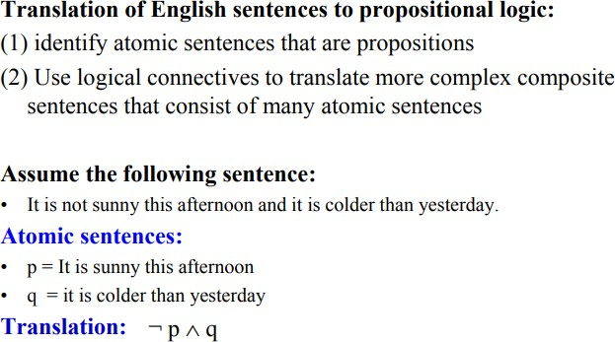
Example
Translation

Slide 24
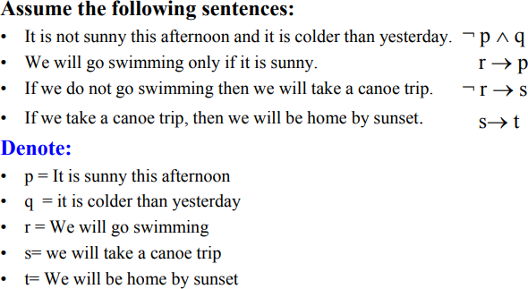
Example
Translation

Slide 25
Formalizing English Sentences
Let’s consider a propositional language where p means ”Priti is happy”, q means ” Priti paints a picture”, and r means ”Renzo is happy”.
Formalize the following sentences:
”if Priti is happy and paints a picture then Renzo isn’t happy”
p 𝖠 q → ¬r
”if Priti is happy, then she paints a picture”
p → q
” Priti is happy only if she paints a picture”
p ⇔ q

Slide 26
Formalizing English Sentences
Let A= ” Angelo comes to the party”,
B= ”Bruno comes to the party”,
C= ”Carlo comes to the party”, and
D =”Davide comes to the party”.
”If Davide comes to the party then Bruno and Carlo come too”
”Carlo comes to the party only if Angelo and Bruno do not come”
”If Davide comes to the party, then, if Carlo doesn’t come then Angelo comes”
”Carlo comes to the party provided that Davide doesn’t come, but, if Davide comes, then Bruno doesn’t come”
”A necessary condition for Angelo coming to the party, is that, if Bruno and Carlo aren’t coming, Davide comes”
”Angelo, Bruno and Carlo come to the party if and only if Davide doesn’t come, but, if neither Angelo nor Bruno come, then Davide comes only if Carlo comes”

Slide 27
Formalizing English Sentences
Let A = ”Angelo comes to the party”,
B = ”Bruno comes to the party”,
C = ”Carlo comes to the party”, and
D = ”Davide comes to the party”.
1. ”If Davide comes to the party then Bruno and Carlo come too”
D → B 𝖠 C
2. ”Carlo comes to the party only if Angelo and Bruno do not come”
C → ¬A 𝖠 ¬B
3. ”If Davide comes to the party, then, if Carlo doesn’t come then Angelo comes”
D → (¬C → A)

Slide 28
Formalizing English Sentences
Let A = ”Angelo comes to the party”,
B = ”Bruno comes to the party”,
C = ”Carlo comes to the party”, and
D = ”Davide comes to the party”.
4. ”Carlo comes to the party provided that Davide doesn’t come, but, if Davide comes, then Bruno doesn’t come”
(C → ¬D) 𝖠 (D → ¬B)
5. ”A necessary condition for Angelo coming to the party, is that, if Bruno and Carlo aren’t coming, Davide comes”
A → (¬B 𝖠 ¬C → D)
6. ”Angelo, Bruno and Carlo come to the party if and only if Davide doesn’t come, but, if neither Angelo nor Bruno come, then Davide comes only if Carlo comes”
(A 𝖠 B 𝖠 C ↔ ¬D) 𝖠 (¬A 𝖠 ¬B → (D → C))

Slide 29
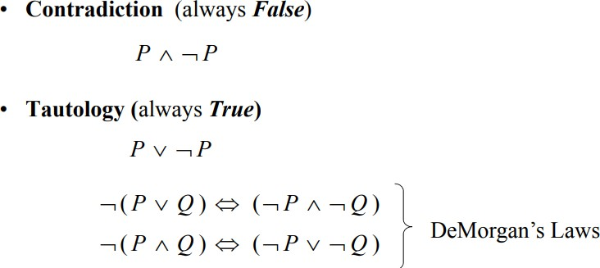
Contradiction and Tautology
Some composite sentences may always (under any interpretation) evaluate to a single truth value:

Slide 30
Rules of Inference
Inference: In artificial intelligence, we need intelligent computers which can create new logic from old logic or by evidence, so generating the conclusions from evidence and facts is termed as Inference.
Inference rules are the templates for generating valid arguments. Inference rules are applied to derive proofs in AI, and the proof is a sequence of the conclusion that leads to the desired goal.
Following are some terminologies related to inference rules:
Implication: It is one of the logical connectives which can be represented as P → Q. It is a Boolean expression.
Converse: The converse of implication, which means the right-hand side proposition goes to the left-hand side and vice-versa. It can be written as Q → P.

Slide 31
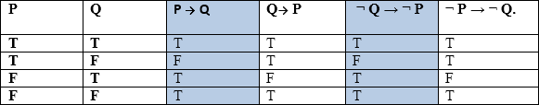
Rules of Inference
Contrapositive: The negation of converse is termed as contrapositive, and it can be represented as ¬ Q → ¬ P.
Inverse: The negation of implication is called inverse. It can be represented as
¬ P → ¬ Q.
From the above term some of the compound statements are equivalent to each other, which we can prove using truth table:

Slide 32

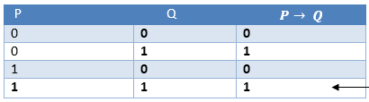
Types of Inference Rules
Modus Ponens: if P and P → Q is true, then we can infer that Q will be true.
Example
Statement-1: "If I am sleepy then I go to bed" ==> P→ Q Statement-2: "I am sleepy" ==> P
Conclusion: "I go to bed." ==> Q.
Hence, we can say that, if P→ Q is true and P is true then Q will be true.
Proof by Truth table:

Slide 33

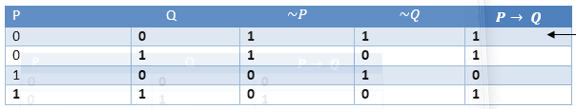
Types of Inference Rules
Modus Tollens: The Modus Tollens rule state that if P→ Q is true and ¬ Q is true, then ¬ P will also true.
Statement-1: "If I am sleepy then I go to bed" ==> P→ Q Statement-2: "I do not go to the bed."==> ~Q Statement-3: Which infers that "I am not sleepy" => ~P
Proof by Truth table:

Slide 34
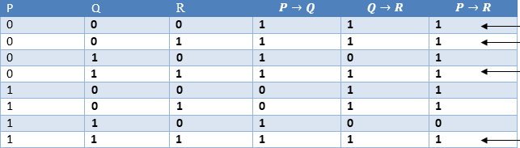
Types of Inference Rules
Hypothetical Syllogism: The Hypothetical Syllogism rule state that if P→R is true whenever P→Q is true, and Q→R is true.
Statement-1: If you have my home key then you can unlock my home. P→Q
Statement-2: If you can unlock my home then you can take my money. Q→R
Conclusion: If you have my home key then you can take my money. P→R
Proof by Truth table:

Slide 35

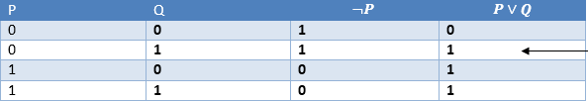
Types of Inference Rules
Disjunctive Syllogism: The Disjunctive syllogism rule state that if P∨Q is true, and ¬P is true, then Q will be true.
Example
Statement-1: Today is Sunday or Monday. ==>P∨Q Statement-2: Today is not Sunday. ==> ¬P Conclusion: Today is Monday. ==> Q
Proof by Truth table:

Slide 36

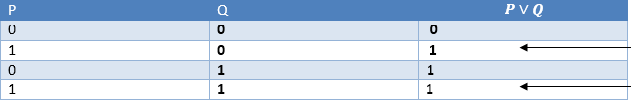
Types of Inference Rules
Addition: The Addition rule is one the common inference rule, and it states that If P is true, then P∨Q will be true.
Example:
Statement: I have a vanilla ice-cream. ==> P
Statement-2: I have Chocolate ice-cream.
Conclusion: I have vanilla or chocolate ice-cream. ==> (P∨Q)
Proof by Truth table:

Slide 37


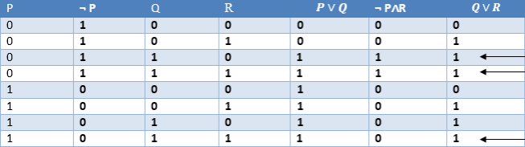
Types of Inference Rules
Simplification: The simplification rule state that if P 𝖠 Q is true, then Q or P will also be true. It can be represented as:
Resolution: The Resolution rule state that if P∨Q and ¬ P𝖠R is true, then Q∨R will also be true. It can be represented as

Slide 38
Logical Representation-Propositional Logic
In order to draw conclusions, facts are represented in a more convenient way as,
1. Marcus is a man.
man(Marcus)
2. Plato is a man.
man(Plato)
3. All men are mortal.
mortal(men)
Caesar was a ruler
ruler(Caesar )

Slide 39
Limitations of Propositional logic
We cannot represent relations like ALL, some, or none with propositional logic.
E.g.
All the girls are intelligent.
Some apples are sweet.
Propositional logic has limited expressive power.
In propositional logic, we cannot describe statements in terms of their properties or logical relationships.

Slide 40
Limitations of Propositional Logic
Propositional logic cannot express general-purpose knowledge briefly
Difficult to identify specific individuals (Mary, among 3)
Generalizations, patterns, regularities difficult to represent (all triangles have 3 sides)
Can’t directly talk about properties of individuals or relations between individuals (e.g., “Bill is tall”)

Slide 41
Propositional Logic VS Predicate Logic
Propositional Logic | Predicate Logic
Propositional logic is the logic that deals with a collection of declarative statements which have a truth value, true or false. | Predicate logic is an expression consisting of variables with a specified domain. It consists of objects, relations and functions between the objects.
It is the basic and most widely used logic. Also known as Boolean logic. | It is an extension of propositional logic covering predicates and quantification.
A proposition has a specific truth value, either true or false. | A predicate’s truth value depends on the variables’ value.
Scope analysis is not done in propositional logic. | Predicate logic helps analyze the scope of the subject over the predicate.
Propositions are combined with Logical Operators or Logical Connectives like Negation(¬), Disjunction(∨), Conjunction(𝖠), Exclusive OR(⊕), Implication(⇒), Bi- Conditional or Double Implication(⇔). | Predicate Logic adds by introducing quantifiers to the existing proposition.

Slide 42
Predicate Logic / First order Logic

Slide 43
First-Order Logic
In propositional logic, we can only represent the facts, which are either true or false. The propositional logic has very limited expressive power. Consider the following sentence, which we cannot represent using PL logic.
"Some humans are intelligent"
To represent the above statements, PL logic is not sufficient, so we required some more powerful logic, such as first-order logic.
First-order logic is an extension to propositional logic.
FOL is sufficiently expressive to represent the natural language statements in a concise way.

Slide 44
First-Order Predicate Calculus
First-order logic (like natural language) does not only assume that the world contains facts like propositional logic but also assumes the following things in the world:
First-Order Logic includes:
Objects: peoples, numbers, places, ideas (atoms)
Relations: relationships between objects (predicates, T/F value)
Example: father(fred, mary)
Properties: properties of atoms (predicates, T/F value) Example: red(ball)
Functions: father-of(mary), next(3), (any value in range)
Constant: function with no parameters, MARY

Slide 45
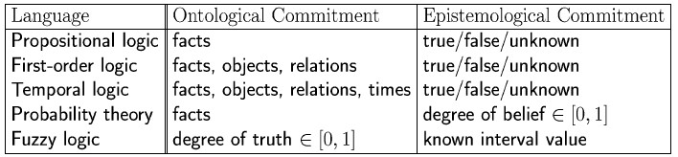
Logics in General
Ontological Commitment:
What exists in the world — TRUTH
PL : facts hold or do not hold.
FOL : objects with relations between them that hold or do not hold
Epistemological Commitment:
What an agent believes about facts — BELIEF

Slide 46
Syntax of FOL: Basic elements
Constant Symbols:
Stand for objects
e.g., KingJohn, 2, UCI,...
Predicate Symbols
Stand for relations
E.g., Brother(Richard, John), greater_than(3,2)...
Function Symbols
Stand for functions
E.g., Sqrt(3), LeftLegOf(John),...

Slide 47
Syntax of FOL: Basic elements
Constants (KingJohn, 2, UCI,...)
Predicates (Brother, >,... Sqrt)
Functions (LeftLegOf,...)
Variables (x, y, a, b,...)
Connectives (¬, ⇒, ∧, ∨, ⇔)
Equality (=)
Quantifiers (∀, ∃)

Slide 48
Free and Bound Variables
The quantifiers interact with variables which appear in a suitable way. There are two types of variables in First-order logic:
Free Variable: A variable is said to be a free variable in a formula if it occurs outside the scope of the quantifier.
e.g. ∀x ∃(y) : [P (x, y, z)], where z is a free variable.
Bound Variable: A variable is said to be a bound variable in a formula if it occurs within the scope of the quantifier.
e.g. ∀x ∀y : [A (x) V B( y)], here x and y are the bound variables.

Slide 49
Syntax: First-Order Logic
Atomic sentences:
Atomic sentences are the most basic sentences of first-order logic. These sentences are formed from a predicate symbol followed by a parenthesis with a sequence of terms.
We can represent atomic sentences as
Predicate(term1,term2,......, term n).
Example: Chinky is a cat: => cat (Chinky).
Complex Sentences:
Complex sentences are made by combining atomic sentences using connectives.

Slide 50
Syntax: First-Order Logic
First-order logic statements can be divided into two parts:
Subject: Subject is the main part of the statement.
Predicate: A predicate can be defined as a relation, which binds two atoms together in a statement.
A predicate is a property that is affirmed or denied about the subject (in logic, we say “variable” or “argument”) of a statement
e.g. "x is an integer.", it consists of two parts, the first part x is the subject of the statement and second part "is an integer," is known as a predicate.
“x is greater than 3”
x |subject is greater than 3 | predicate

Slide 51
Syntax: First-Order Logic
We introduce a (functional) symbol for the predicate, and put the subject as an argument (to the functional symbol): P(x)
Examples:
Father(x): unary predicate
Brother(x,y): binary predicate
Sum(x,y,z): ternary predicate
P(x,y,z,t): n-ary predicate

Slide 52
Syntax: First-Order Logic
Quantifiers in First-order logic
A predicate becomes a proposition when we assign it fixed values. However, another way to make a predicate into a proposition is to quantify it. That is, the predicate is true (or false) for all possible values in the universe of discourse or for some value(s) in the universe of discourse
These are the symbols that permit to determine or identify the range and scope of the variable in the logical expression. There are two types of quantifier:
Universal Quantifier, (for all, everyone, everything)
Existential quantifier, (for some, at least one).

Slide 53
Syntax: First-Order Logic
Universal Quantifier
Universal quantifier is a symbol of logical representation, which specifies that the statement within its range is true for everything or every instance of a particular thing.
The Universal quantifier is represented by a symbol ∀, which resembles an inverted A.
If x is a variable, then ∀x is read as:
For all x
For each x
For every x.
E.g. All man drink coffee. ∀x man(x) → drink (x, coffee).

Slide 54
Syntax: First-Order Logic
Existential Quantifier
Existential quantifiers are the type of quantifiers, which express that the statement within its scope is true for at least one instance of something.
It is denoted by the logical operator ∃, When it is used with a predicate variable then it is called as an existential quantifier.
If x is a variable, then existential quantifier will be ∃x or ∃(x). And it will be read as:
There exists a 'x.'
For some 'x.'
For at least one 'x.'
E.g. Some boys are intelligent. ∃x: boys(x) 𝖠 intelligent(x)

Slide 55
Syntax: First-Order Logic
Well Formed Formula (wff):
A well-formed formula is obtained by composing atoms with logical connectives and quantifiers. Therefore, a well-formed formula is a predicate with the following properties:
All atomic formulas (atoms) are well-formed formulas.
Combines using propositional connectives such a conjunction, disjunction and negation.
If x is a variable and F is a well formed formula function, then both quantifiers are well formed formulas.
A well-formed formula (wff) is a sentence containing no “free” variables. That is, all variables are “bound” by universal or existential quantifiers.

Slide 56
Syntax: First-Order Logic
The Syntactic Rules (Individual terms are just the individual constants and individual variables)
If P is an n-place predicate, and t1, t2, …, tn are terms, then P(t1, t2, …, tn) is a wff
If ϕ and ψ are wff, then ¬ϕ, (ϕ 𝖠 ψ), (ϕ ∨ ψ), (ϕ → ψ), (ϕ ↔ ψ) are wffs
If ϕ is a wff and x is an individual variable, then ∀x ϕ and ∃x ϕ are wffs
Nothing else is a wff

Slide 57
Syntax: First-Order Logic
Well Formed Formula: A well-formed formula (wff) is a sentence containing no “free” variables. That is, all variables are “bound” by universal or existential quantifiers.
Quantifiers
Universal quantification :- (∀x)P(x) means that P holds for all values of x in the domain associated with that variable
E.g., (∀x) dolphin(x) → mammal(x)
Existential quantification :- (∃ x)P(x) means that P holds for some value of x in the domain associated with that variable
E.g., (∃x) mammal(x) 𝖠 lays-eggs(x)

Slide 58
Syntax: First-Order Logic
Properties of Quantifiers:
In universal quantifier, ∀x∀y is similar to ∀y∀x.
In Existential quantifier, ∃x∃y is similar to ∃y∃x.
∃x∀y is not similar to ∀y∃x. Why? Example:
1) ∀x∃y: For every x there exists a y (such that...)
Everyone is married to someone (ie. For every person there exists a person to whom he/she is married)
2) ∃y∀x: There exists a y (such that) for every x...
Someone is married to everyone (ie. There is someone who is married to everyone)

Slide 59
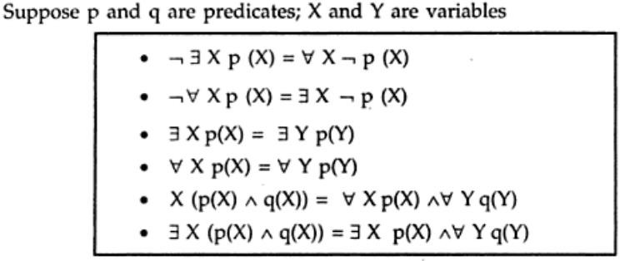
Syntax: First-Order Logic
Some Predicate Calculus Equivalence

Slide 60
Examples
No human enjoys golf
∀x[Human(x) → ¬Enjoys(x, Golf )
Some professor that is not a historian writes programs
∃x[Pr ofessor(x) ∧ ¬Historian(x) ∧ Writes(x, Pr ograms)]
All birds fly.
Every man respects his parent.
Some boys play cricket.
Not all students like both Mathematics and Science.
¬∀ (x) * student(x) → like(x, Mathematics) 𝖠 like(x, Science)].
∀x bird(x) →fly(x).
∀x man(x) → respects (x, parent).
∃x boys(x) ^ play(x, cricket).

Slide 61
Unification
Unification is a process of making two different logical atomic expressions identical by finding a substitution. Unification depends on the substitution process.
It takes two literals as input and makes them identical using substitution.
Let Ψ₁ and Ψ₂ be two atomic sentences and 𝜎 be a unifier such that, Ψ₁𝜎
= Ψ₂𝜎, then it can be expressed as UNIFY(Ψ₁, Ψ₂).
Example: Let Ψ₁ = King(x), Ψ₂ = King(John),
Substitution θ = {John/x} is a unifier for these atoms and applying this substitution, and both expressions will be identical.

Slide 62
Unification
The UNIFY algorithm is used for unification, which takes two atomic sentences and returns a unifier for those sentences (If any exist).
Unification is a key component of all first-order inference algorithms.
It returns fail if the expressions do not match with each other.
The substitution variables are called Most General Unifier or MGU.
E.g. Let's say there are two different expressions, P(x, y), and P(a, f(z)).
Substitute x with a, and y with f(z) in the first expression, and it will be represented as a/x and f(z)/y.
With both the substitutions, the first expression will be identical to the second expression and the substitution set will be: [a/x, f(z)/y].

Slide 63
Unification
Conditions for Unification:
Predicate symbol must be same, atoms or expression with different predicate symbol can never be unified.
Number of Arguments in both expressions must be identical.
Unification will fail if there are two similar variables present in the same expression.

Slide 64
Unification Algorithm
Initial predicate symbols must match.
For each pair of predicate arguments:
different constants cannot match.
a variable may be replaced by a constant.
a variable may be replaced by another variable.
a variable may be replaced by a function as long as the function does not contain an instance of the variable.
When attempting to match 2 literals, all substitutions must be made to the entire literal.
There may be many substitutions that unify 2 literals, the most general unifier is always desired.

Slide 65
Unification Examples
P(x) and P(y): substitution = (x/y) (“substitute x for y”)
P(x,f(y)) and P(Joe,z):(Joe/x, f(y)/z)
P(x) V Q(Jane) and P(Bill) V Q(y): Bill/x, Jane/y)
Man(Marcus) and ¬Man(spot) ((Not unified)
Man(Marcus) and Man(Marcus, X) (Not unified)
Man(Marcus) and Man(X) (X is substitute to Marcus so unified)
Man(hate(X,Y)) and Man(hate(Marcus, spot)) (Marcus/X and spot/Y)

Slide 66
Normal Forms
Other approaches to inference use syntactic operations on sentences, often expressed in standardized forms
Conjunctive Normal Form (CNF)
Conjunction of disjunctions of literals (conjunction of clauses) e.g. (A v –B) ^ (B v –C v –D)
Disjunctive Normal Form (DNF)
disjunction of conjunctions of literals (disjunction of terms)
e.g. (A ^ B) v (A ^ -C) v (A ^ -D) v (-B ^ -C) v (-B ^ -D)
Horn Form (restricted)
conjunction of Horn clauses (clauses with <= 1 positive literal) For example, (A v –B) ^ (B v –C v –D)
Often written as a set of implications: B -> A and (C ^ D) -> B

Slide 67
Convert first-order logic expressions to normal form
Why CNF (Conjunctive Normal Form)?
To make our representation simple.
In wff, our representation of fact is very complicated.
In CNF form, simplicity should be there, embedding should not be there and all quantifiers should not be there.
Example: All Romans who know Markus either hate Ceaser or think that any one who hates anyone is crazy.
∀ x: [ roman(x) ^ know(x , Markus) ] -> [hate(x, ceaser) V (∀ y: ∃ z: hate(y,z)
-> thinkcrazy(x,y) ]

Slide 68
Convert first-order logic expressions to normal form
Rules to convert wff to CNF
Step-1: Eliminate biconditionals and implications:
Eliminate ⇔, replacing α ⇔ β with (α ⇒ β) 𝖠 (β ⇒ α).
Eliminate ⇒, replacing α ⇒ β with ¬α ∨ β.
Step-2: Move ¬ inwards:
¬(∀ x p) ≡ ∃ x ¬p,
¬(∃ x p) ≡ ∀ x ¬p,
¬(α ∨ β) ≡ ¬α 𝖠 ¬β,
¬(α 𝖠 β) ≡ ¬α ∨ ¬β,
¬¬α ≡ α.

Slide 69
Convert first-order logic expressions to normal form
Rules to convert wff to CNF
Step-3: Standardize variables apart by renaming them: each quantifier should use a different variable.
Step-4. Skolemize: each existential variable is replaced by a Skolem constant or Skolem function of the enclosing universally quantified variables.
For instance, ∃x Rich(x) becomes Rich(G1) where G1 is a new Skolem constant.
“Everyone has a heart” ∀ x Person(x) ⇒ ∃ y Heart(y) 𝖠 Has(x, y) becomes
∀ x Person(x) ⇒ Heart(H(x)) 𝖠 Has(x, H(x)), where H is a new symbol (Skolem function).

Slide 70
Convert first-order logic expressions to normal form
Rules to convert wff to CNF
Step-5: Convert to prenex form by moving all universal quantifiers to the beginning of the wff.
wff in prenex form = Prefix (string of quantifiers) + Matrix (quantifier-free formula)
Step-6: Drop universal quantifiers
For instance, ∀ x Person(x) becomes Person(x).
Step-7. Distribute 𝖠 over ∨: Use distributive laws and equivalence rules of propositional logic to transform the matrix to CNF.
(α 𝖠 β) ∨ γ ≡ (α ∨ γ) 𝖠 (β ∨ γ).

Slide 71
Skolem functions
∃ y President(y)
We replace y with a new function func:
President(func())
func is called a skolem function. Example:
" ∀ x ∃ y Father(y,x)
create a new function named foo and replace y with the function. " ∀ x Father(foo(x),x)

Slide 72
Convert first-order logic expressions to normal form
Example
∀ x: (¬ literate(x) -> (¬write(x) ^ (¬ ∃y: (read(x,y) ^ book(y)))
Eliminate implications ⇔⇔, ⇒
∀ x: literate(x) V (¬write(x) ^ ∀y: ¬(read(x,y) ^ book(y))
Reduce scope of negations:
∀ x: literate(x) V (¬write(x) ^ ∀y: ¬read(x,y) V ¬book(y))
Standardize variables
skip this step
Prenex form:
∀ x: ∀y: literate(x) V (¬write(x)) ^ (¬read(x,y) V ¬book(y))

Slide 73
Convert first-order logic expressions to normal form
Drop universal quantifiers
literate(x) V (¬write(x)) ^ (¬read(x,y) V ¬book(y))
Conjuction and disjunction
A V (B ^ (C VD)) = (A V B) ^ (A V (C V D))
where (C V D) = X
(literate(x) V ¬write(x)) ^ (literate (x) V (¬read(x,y) V ¬book(y))) Here, A ^ B so A and B both are considered as separate facts.
literate(x) V ¬write(x)
literate (x) V (¬read(x,y) V ¬book(y))

Slide 74
Resolution
Resolution is a procedure to prove a statement.
Steps for Resolution:
Conversion of facts into first-order logic.
Convert FOL statements into CNF
Negate the statement which needs to prove (proof by contradiction)
Draw resolution graph (unification). (From Knowledge base find out fact/term as negative meaning so both will be elemented)
Resolvent: From two parent clauses which was derived is called as resolvent.

Slide 75
Resolution
Example
Marcus was a man
Marcus was a Pompeian
All Pompeians were Romans
Caesar was a ruler.
All Romans were either loyal to Caesar or hated him.
Everyone is loyal to someone.
Men only try to assassinate rulers they are not loyal to.
Marcus tried to assassinate Caesar

Slide 76
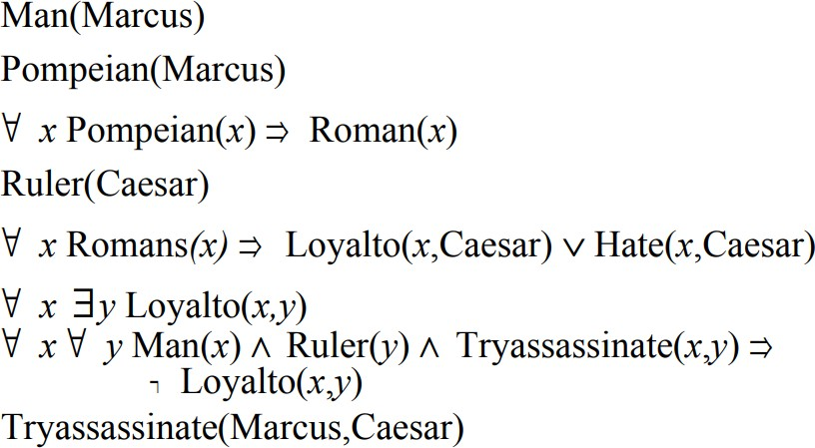
Knowledge Base in First Order Logic

Slide 77
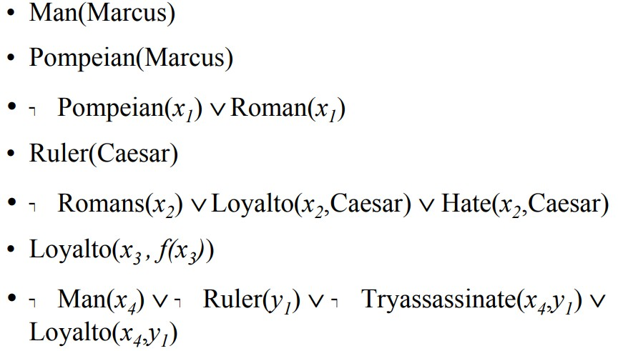

Knowledge Base in CNF
Tryassassinate(Marcus,Caesar)

Slide 78
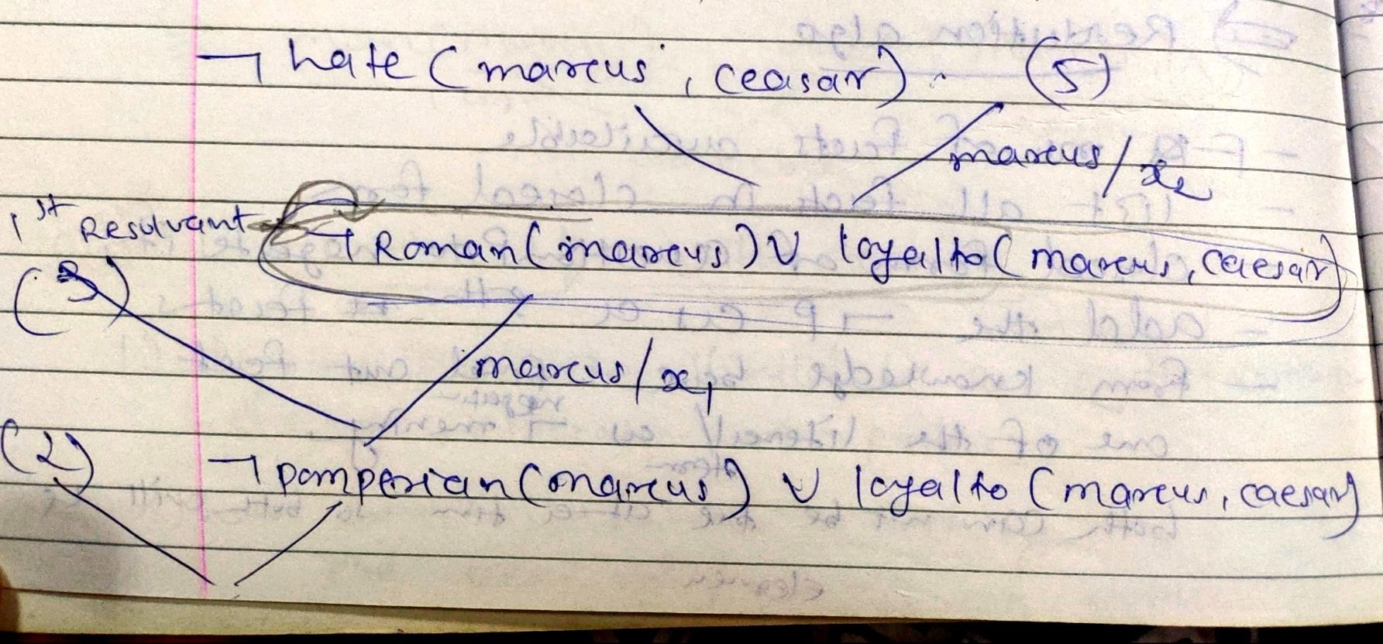
Knowledge Base in CNF
Query: Does Marcus hate Caesar?
Negation of Query ¬Hate(Marcus, Caesar)

Slide 79
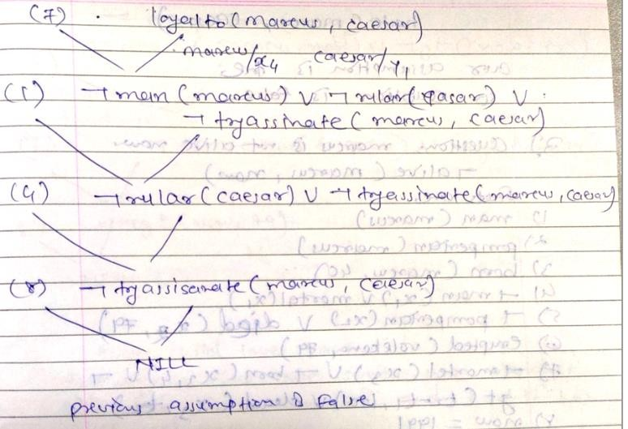
Resolution
Does Marcus hate Caesar?
So hate(Markus, ceaser) is true.

Slide 80
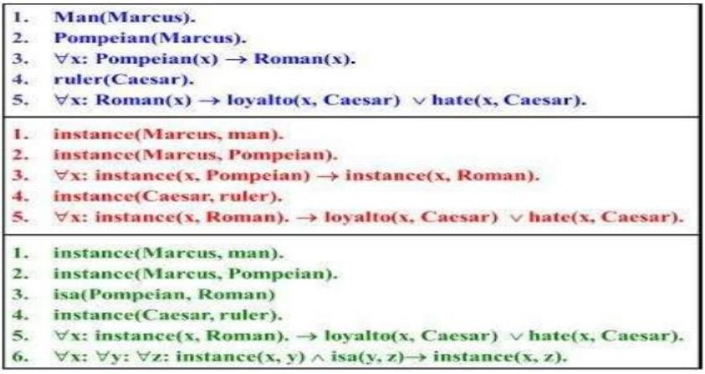
Representing Instance and ISA Relationships
Specific attributes instance and isa play an important role particularly in a useful form of reasoning called property inheritance.
The predicates instance and isa explicitly captured the relationships they used to express, namely class membership and class inclusion.

Slide 81
Representing Instance and ISA Relationships
The first part of the figure contains, class membership represented with unary predicates (such as Roman), each of which corresponds to a class.
Asserting that P(x) is true is equivalent to asserting that x is an instance (or element) of P.
The second part of the figure contains representations that use the instance predicate explicitly.
The predicate instance is a binary one, whose first argument is an object and whose second argument is a class to which the object belongs.
But these representations do not use an explicit isa predicate.
Instead, subclass relationships, such as that between Pompeians and Romans, described as shown in sentence 3.

Slide 82
Representing Instance and ISA Relationships
The implication rule states that if an object is an instance of the subclass Pompeian then it is an instance of the superclass Roman.
The third part contains representations that use both the instance and isa predicates explicitly.
The use of the isa predicate simplifies the representation of sentence 3, but it requires that one additional axiom (shown here as number 6) be provided.

Slide 83
Computable Functions and Predicates
To express simple facts, such as the following greater-than and less-than relationships:
gt(1,O) It(0,1) gt(2,1) It(1,2) gt(3,2) It( 2,3)
It is often also useful to have computable functions as well as computable predicates.
Thus we might want to be able to evaluate the truth of gt(2 + 3,1)
To do so requires that we first compute the value of the plus function given the arguments 2 and 3, and then send the arguments 5 and 1 to gt.

Slide 84
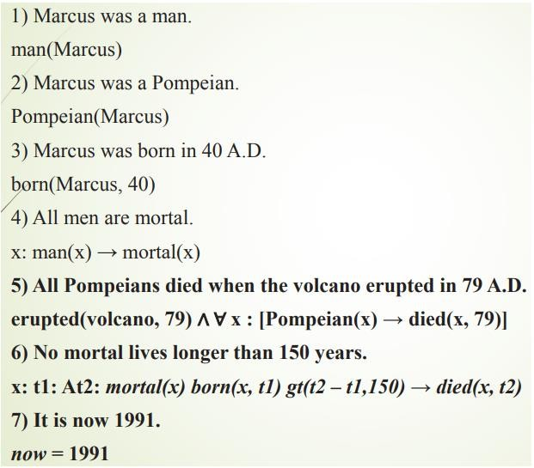
Computable Functions and Predicates
Consider the following set of facts, again involving Marcus:

Slide 85
Computable Functions and Predicates
So, Now suppose we want to answer the question “Is Marcus alive?”
The statements suggested here, there may be two ways of deducing an answer.
Either we can show that Marcus is dead because he was killed by the volcano or we can show that he must be dead because he would otherwise be more than 150 years old, which we know is not possible.
Also, As soon as we attempt to follow either of those paths rigorously, however, we discover, just as we did in the last example, that we need some additional knowledge. For example, our statements talk about dying, but they say nothing that relates to being alive, which is what the question is asking.

Slide 86
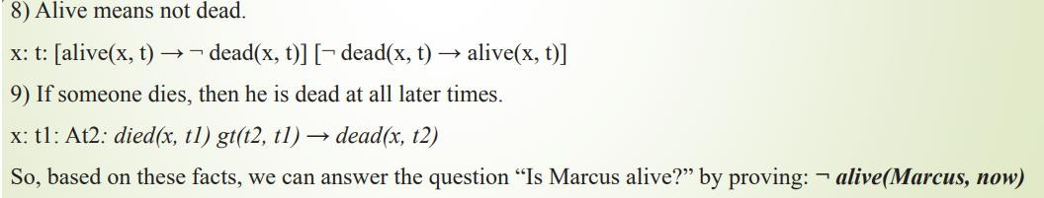
Computable Functions and Predicates
So we add the following facts:

